Slide 1
Geografski položaj Novog zelanda
Antun mirković

Slide 2
New Zealand is located in the southern part of the Pacific Ocean, approximately 2,000 km southeast of Australia

Slide 3
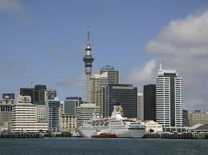

Slide 4
on the west side of the island is a narrow coastal plains (ie. Westland), on the east coast 240 km long and 70 km wide plains (Canterbury Plains)

Slide 6
North and South Island separates the 23 km wide Cook Inlet that was created by transverse faults only in the Pliocene.

Slide 7
